Slide 1
Creative Arts – Music
Year 8

Slide 2
What do you do?
Develop instrumental music skills as a soloist and as part of an ensemble.
Learn about the elements of music.
Analyse different musical genres and cultures such as blues, rock and classical music.
Read, write and improvise music.
Analyse film music and musical theatre.
Compose original music using music digital software.
Record original and prescribed music using a variety of digital audio software using the school’s DAW.

Slide 3
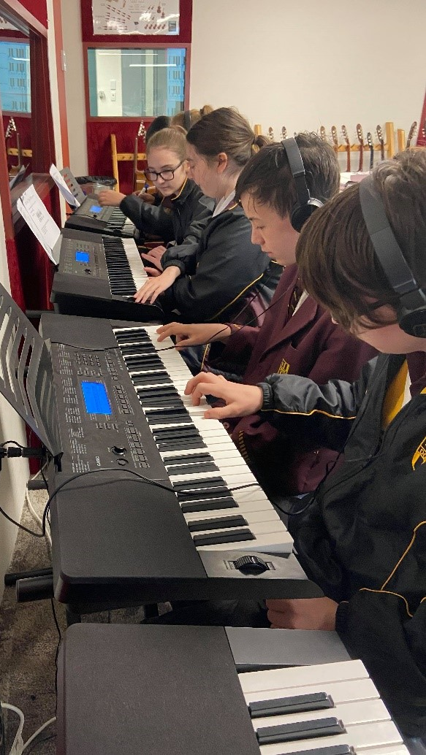
What you need?
A willingness to develop performance and musicianship skills.
Energy and enthusiasm.
Creativity.
Previous experience with a musical instrument.
Commitment to learning a musical instrument.

Slide 4
Find out more…
Please feel free to contact Mr Mike O’Brien, Head of Creative Arts, at mobrien@dominic.tas.edu.au

